Slide 1

Best Place for Business in Haiti
September
2021
Author : David Louis

Slide 2
What Is The Best Municipality To Start Your Business? Or What Is The Next Location To Expand Your Business?

Slide 3
Introduction
Business Location Analysis is a technique for discovering,
assessing and specifying the optimal placement
to start or to expand business activities.

Slide 4

Target Audience
Entrepreneur

Slide 5
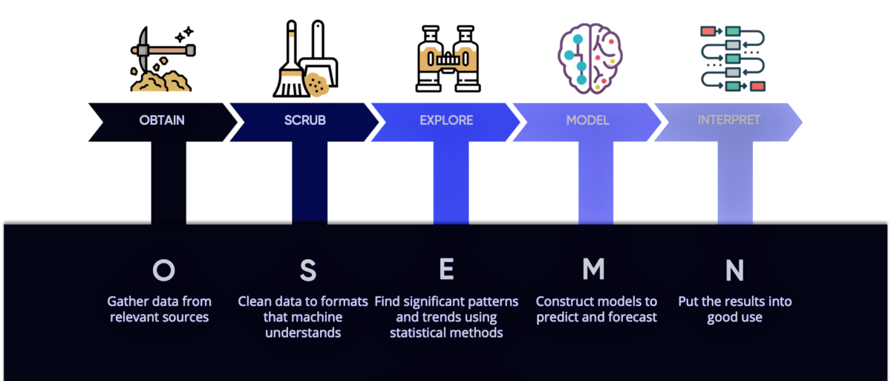
Methodology

Slide 6
Data Sample
Municipality
25
Business
5265
Business Line
28

Slide 7
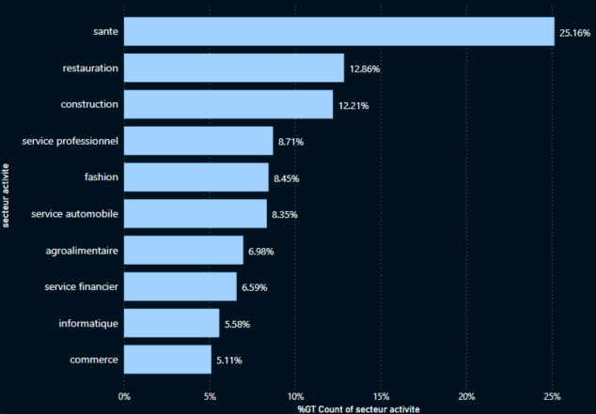
Top 10 business line in the country

Slide 8
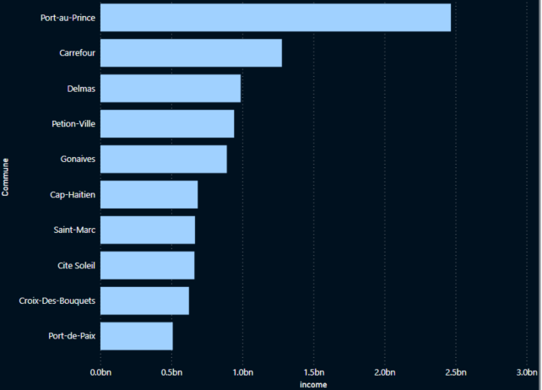
Top 10 Municipality
With the highest
Level of income

Slide 9
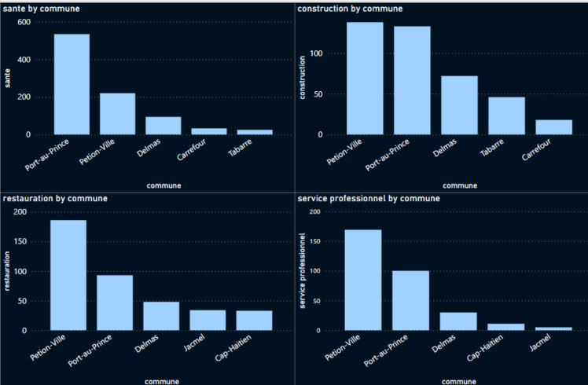
Top 4
Business Line
By Municipality

Slide 10
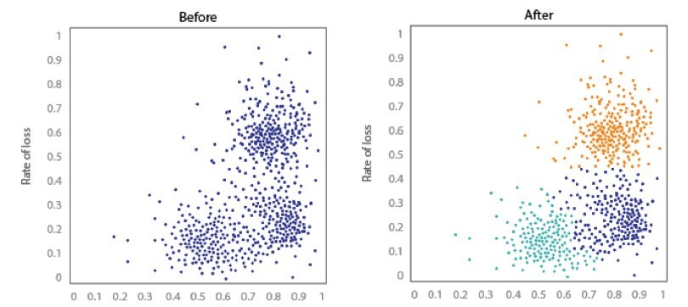
Clustering Analysis
The machine learning model segmented the data by municipality based on business line and demographics
such as gender distribution and Level of income.

Slide 11
Cluster Analysis
Cluster 1
Cluster 2
Cluster 3
Cluster 1 is characterized by communes with an income between 400 million and 1 billion gourdes.
Cluster 2 is characterized by communes that have an income of less than or equal to 400 million gourdes.
Cluster 3 is characterized by 8.46% of communes with an income of less than or equal to 400 million gourdes, 20.66% of communes with a Wage Bill between 400 million and 1 billion gourdes, and 70.86% of communes with a Wage Bill between 1 billion and 3 billion gourdes.

Slide 12
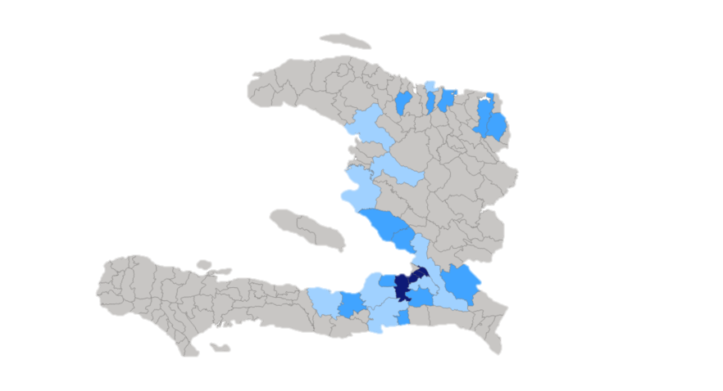
Low Income
Medium Income
Cluster distribution
by municipality
High Income

Slide 13

Thank you
David LOUIS
Téléphone
+509 4485-8714
E-mail
davidlouis301@yahoo.fr
GitHub Link
GitHub link to the project

